Slide 1
Modeling Bias and Ideological Leaning in Journalism
Bradley Abelman (babelman)

Slide 2
Introduction
Ideology and author bias has seeped further into journalism. It is increasingly difficult to determine the credibility of articles that we come across on a daily basis.
We need to consider the broader context of the author’s views and biases in order to properly consume news content, otherwise we may accept opinion as fact and lose sight of what is true.

Slide 3
Introduction
MIT’s Computer Science and AI Lab (CSAIL) designed a model to identify the factuality and bias of news in 2018. This model had a decent level of accuracy, but only looked at news sources as a whole. This ignores the fact that outlets may have several journalists with different ideologies and levels of integrity.
We designed a model that identifies factuality, bias, and political ideology on a per-article basis.

Slide 4
Introduction
MIT’s Computer Science and AI Lab (CSAIL) designed a model to identify the factuality and bias of news in 2018. This model had a decent level of accuracy, but only looked at news sources as a whole. This ignores the fact that outlets may have several journalists with different ideologies and levels of integrity.
We designed a model that identifies factuality, bias, and political ideology on a per-article basis.

Slide 5
Methods
We created a hybrid model of LSTM and a feed-forward NN.
Bi-LSTM was the optimal choice due to its ability to capture textual relationships both forward and backward in the long-term, which is perfect for lengthy articles.
We also trained our own embeddings since widely available embeddings are likely too broad to capture the nuance in political news discussion.

Slide 6
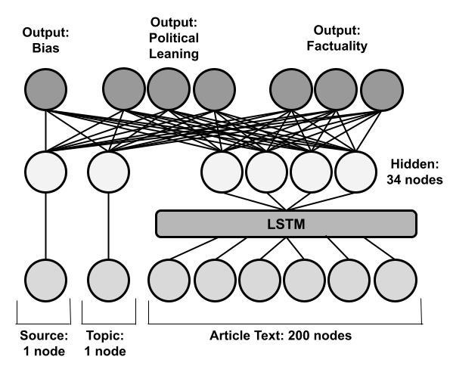
Methods
The news organization, article topic, and text were used as input to the model. The LSTM took in the text and processed it for the hidden layer where it met back up with the topic and source. Then, all hidden layer nodes are used to create predictions for each of the 8 labels:
(2 bias, 3 political leaning, 3 factuality)

Slide 7
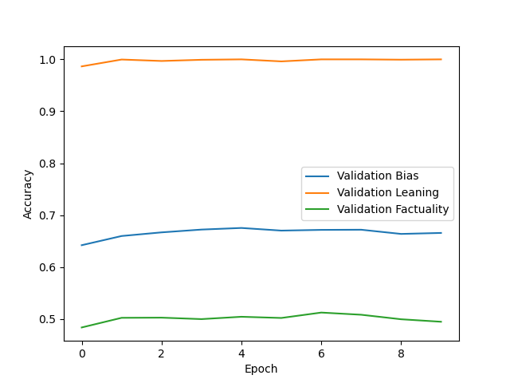
Experiments
The model had a bias accuracy of 67%, a factuality accuracy of over 50% and a political ideology accuracy of nearly 100%. We also tested the model with only the text of the article (no source or topic), resulting in minimal change of accuracy. The bias accuracy actually increased by 0.7%

Slide 8
Discussion
Determining the political leaning of an article is incredibly simple, likely due to the fact that different ideologies have different diction in writing.
Factuality was the most difficult to predict. If we were to spend a year continuing this project, we’d like to integrate a NLI model to compare the sentences to check for inconsistency. We believe that this would increase the factuality accuracy substantially and also make it possible to label articles real or satirical.

